Slide 1

Research trends on coexistence between active & passive services
Yan Soldo, Juliette Challot, Bruno Espinosa, Josep Roselló
RFI workshop 2025, 21-22 October 2025, online
ESA UNCLASSIFIED – For ESA Official Use Only

Slide 2
Outline
Background
Review of dynamic active-passive spectrum sharing approaches
Future challenges involving sharing with passive EO sensors
Lessons learnt from WiFi and weather radars in C-band
Conclusions

Slide 3
Background

Slide 4
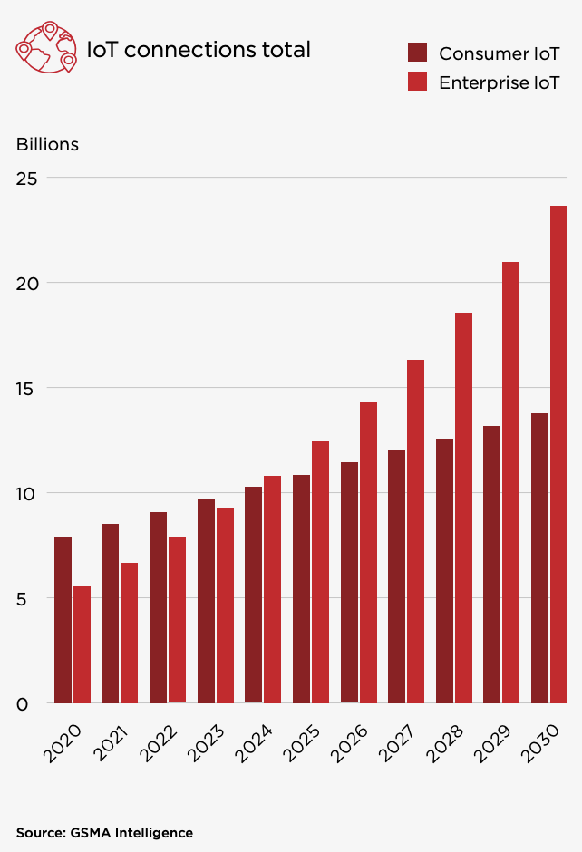
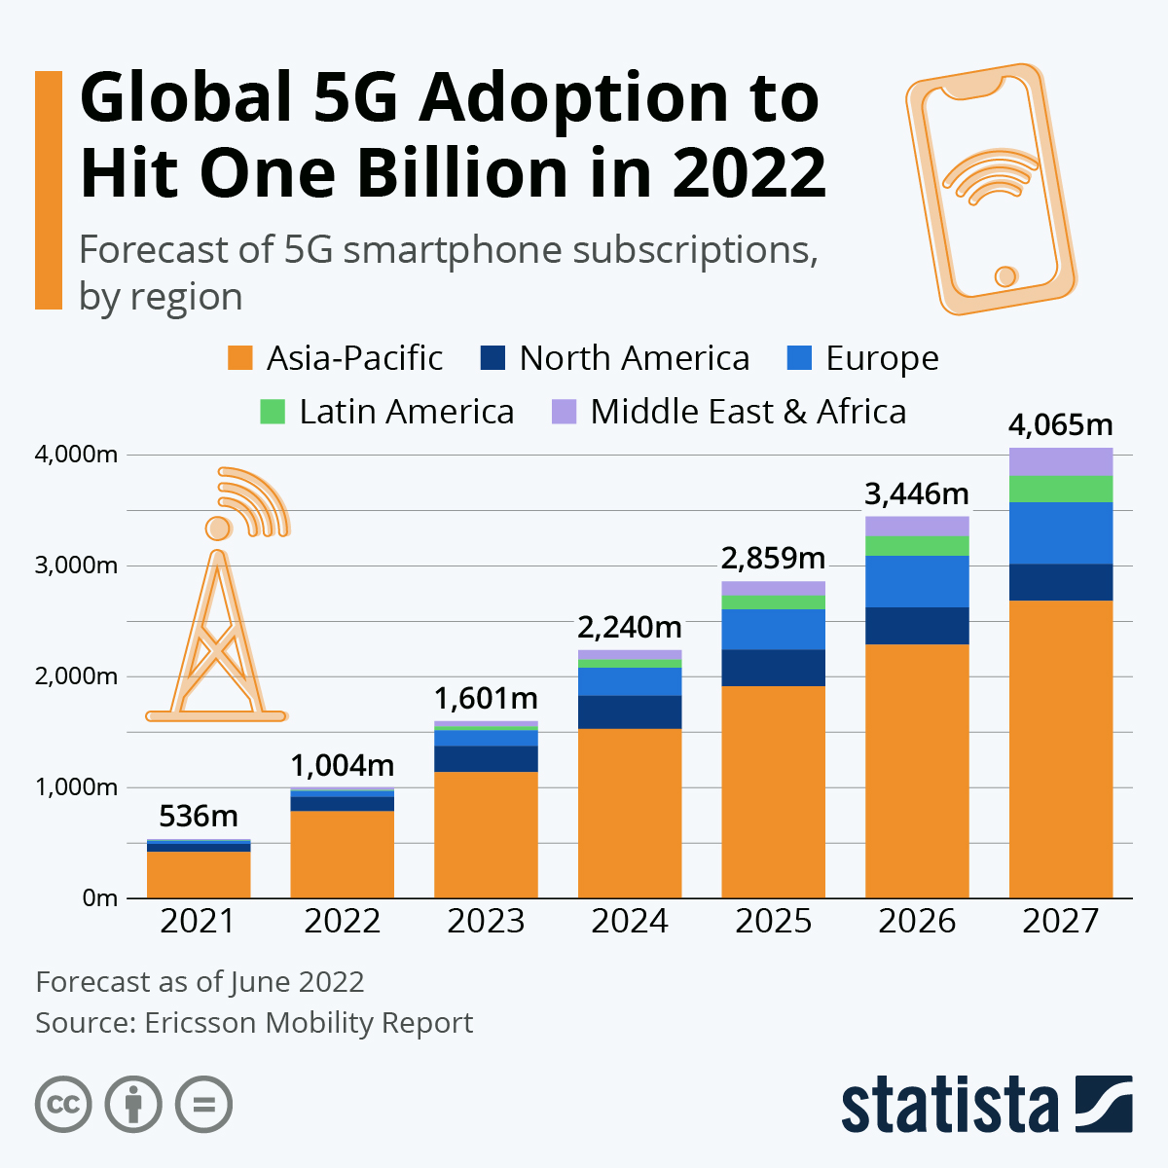
Increasing spectrum needs
Many services are planning to use spectrum more intensively.

Slide 5
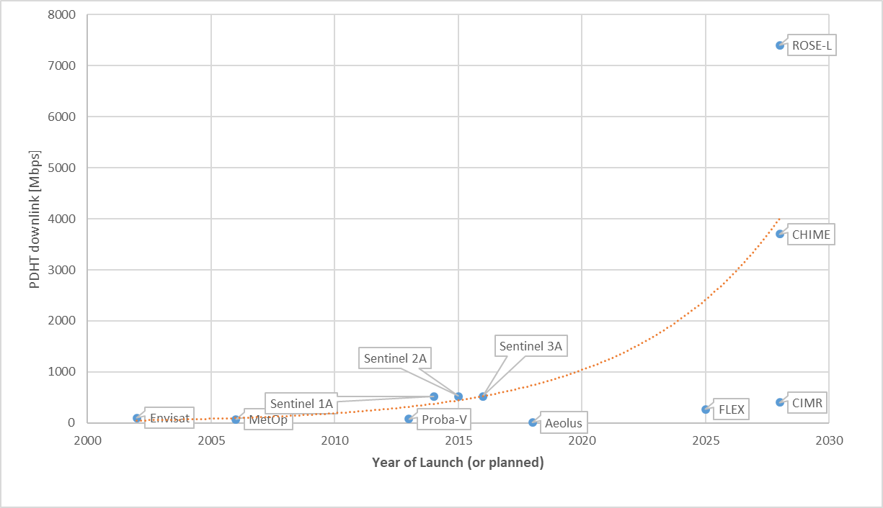
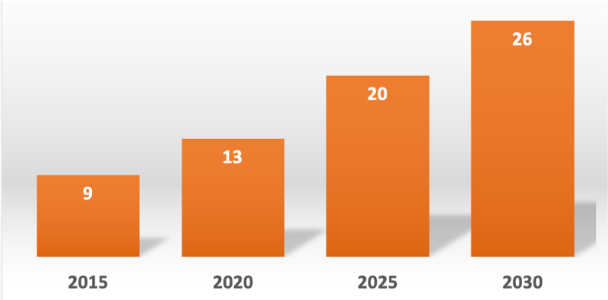
Increasing spectrum needs
Same goes for Earth Observation satellites:
Payload data downlinks
MW sensors
Number of bands targeted by ESA sensors
(between 0.4 and 700 GHz)
Good to increase efficiency in spectrum use

Slide 6
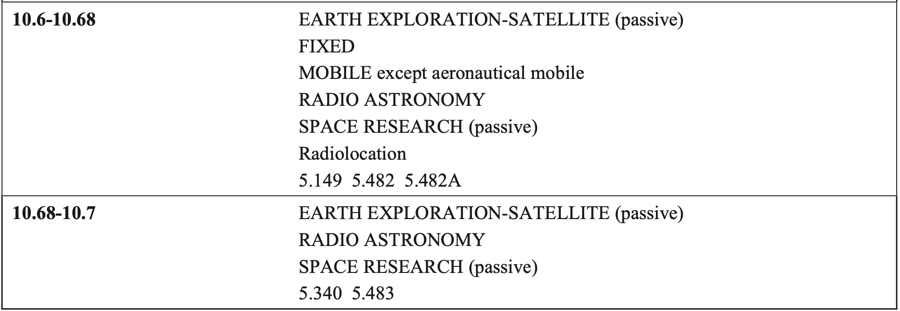
Regulations for EO passive sensors
Radiometers operate within the “Earth Exploration-Satellite Service (passive)”
Two types of allocations:
Shared with active services
Shared with passive services
(all emissions prohibited)
Active/passive coexistence is already in place in several bands.

Slide 7
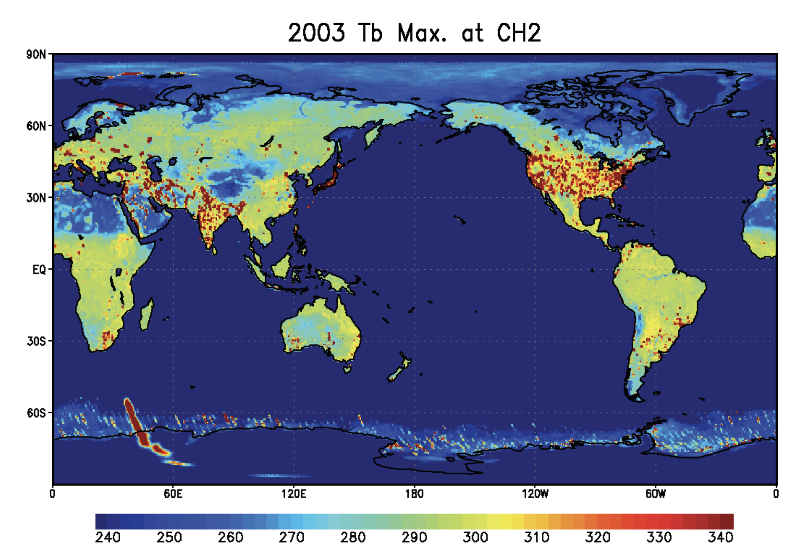
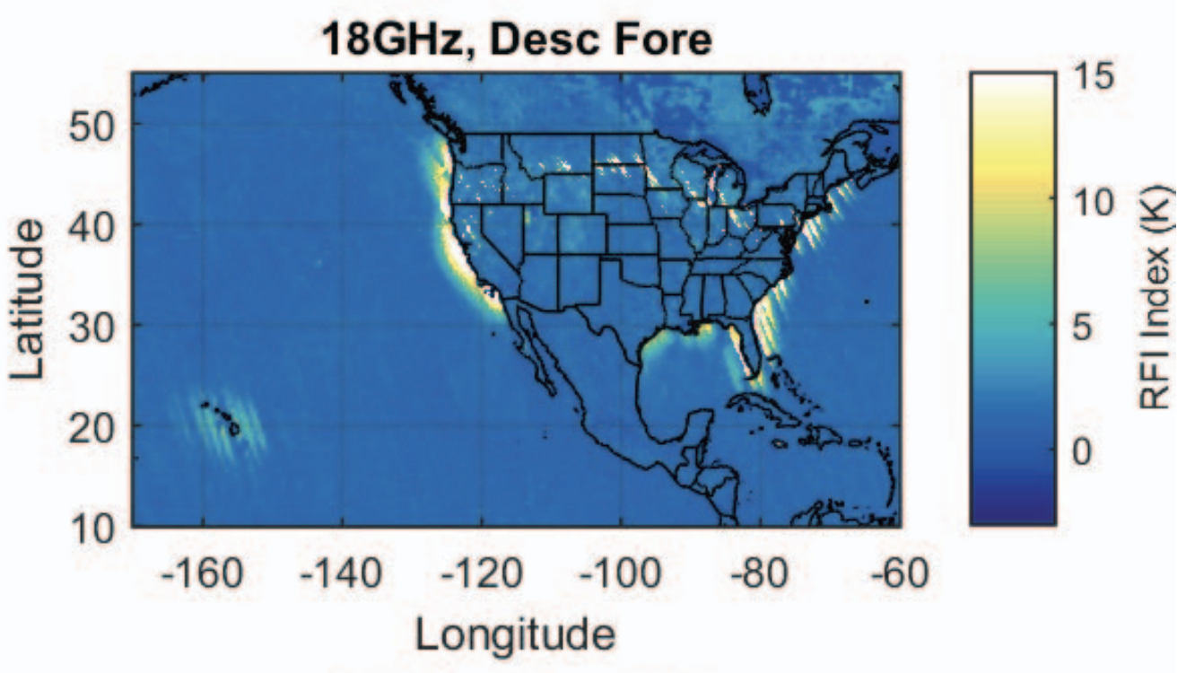
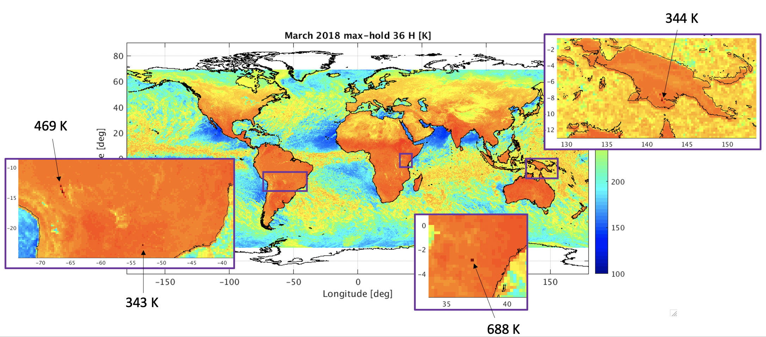
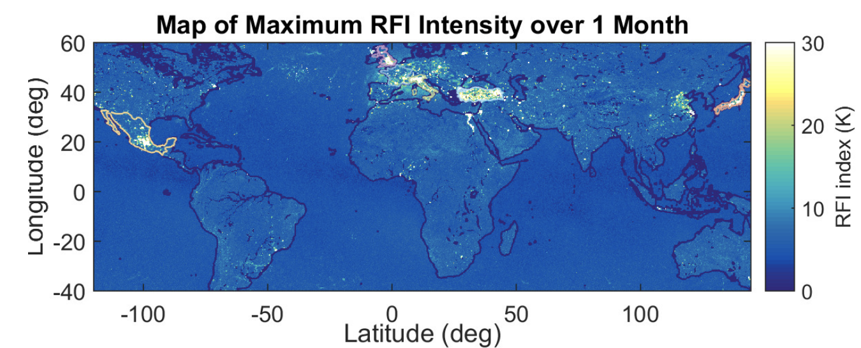
Examples of active-passive coexistence
6.425-7.25 GHz (Maeda et al., 2011)
18.6-18.8 GHz (Draper, 2016)
36-37 GHz
10.6-10.7 GHz (Draper and de Matthaeis, 2018)

Slide 8
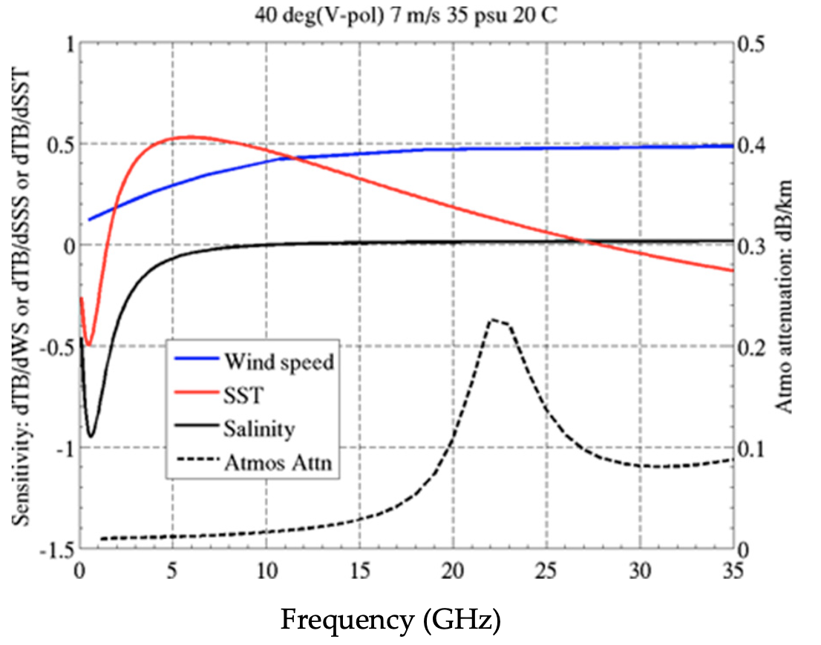
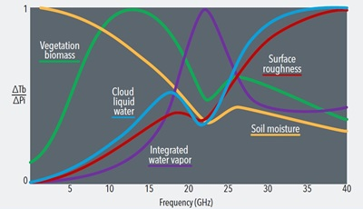
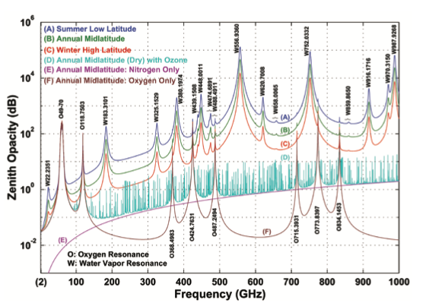
Purely passive bands
Purely passive bands correspond to unique spectral resources, which are linked to physics and thus immutable.
Also, radiometers measure the faint natural thermal noise, so they need quiet bands to perform their measurements
ATMOSPHERE
OCEAN
LAND
Le Vine and Dinnat, 2020
Kerr et al., 2000
Klein and Gasiewski, 2000

Slide 9
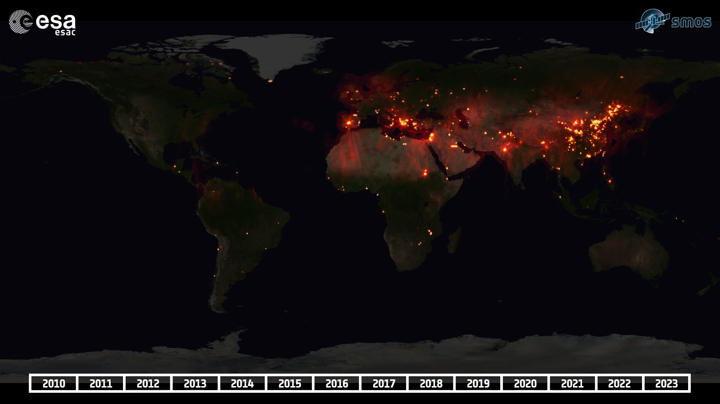
Purely passive bands
Active services cause RFI also in bands where all emissions are prohibited.
E.g.: SMOS (Soil Moisture and Ocean Salinity), operating at 1.4 GHz
Credit: SMOS DPGS RFI Team, ESA-ESAC
Need for efficient spectrum use, but also need for RFI-free spectrum access!

Slide 10
Review of spectrum sharing strategies

Slide 11
Strategies for active-passive coexistence
Many recent papers have presented potential ways for active-passive coexistence.
Static
Dynamic
E.g. Spread-spectrum; power limits;
OOBE limits
Change of behaviour whenever the passive sensor is “present”
Similar approaches in the Radio Regulations
“Time” aspect mostly absent from the RR

Slide 12
Strategies for active-passive coexistence
Static
Dynamic
Planning-based
Cognitive Radios
Broker-based
Based on a-priori information, the active services stop when the EO satellite is expected to be “present”
Active services stop when they receive a “stop” signal from the EO satellite
EO satellites and active services send requests to a Broker, which evaluates interference and manages traffic

Slide 13
Strategies for active-passive coexistence
Planning-based
Cognitive Radios
Broker-based
Potential risks/challenges:
Increased complexity of active systems
Increased complexity of EO satellites
Potential RFI to EO before the “stop” signal
Plan ≠ Reality
Vulnerability to spoofing
Trust / authority of broker
Issue of scale

Slide 14
Experience in Radioastronomy
Satellite communications:
1990
2000
2010
2020
Iridium (L-band)
Beams switched off to avoid RAS sites Agreement with CRAF; update of ITU documents (e.g. Rec RA.1513)
SpaceX (X-band)
Data sharing; avoid RAS sites
Tests with the VLA (NM, USA) Expansion to sites in US and AUS
AST SpaceMobile (L-band)
Ongoing discussions with NRAO
EO Active sensing:
2000
2010
2020
CloudSat (W-band)
RAS sites to point away when needed
SFCG Resolution; Rec RA.1750
EarthCARE (W-band)
Turns off near RAS sites
Agreement with ESA; SFCG webpage
Regular update of SFCG Deliverables

Slide 15
Experience in Radioastronomy
Generally positive outcome (e.g. statements from NRAO and NSF about coordination with SpaceX).
But, there are differences between RAS and EO passive sensors:
A single company is involved in each agreement to protect RAS. To protect EO sensors, a large number of companies/manufacturers/administrations would need to be involved
Fewer active systems/satellites are in visibility of the RAS site
More control over the passive receiver
What worked in RAS may not really work for EO.

Slide 16
Future challenges involving EO sensors

Slide 17
Future challenges involving EO sensors
Dynamic spectrum sharing may lead to a more efficient spectrum use,
which would help address the issue of increasing needs for spectrum.
However, when it comes to coexistence between EO sensors and active systems,
some challenging aspects are not yet properly addressed in the research body on this topic.

Slide 18
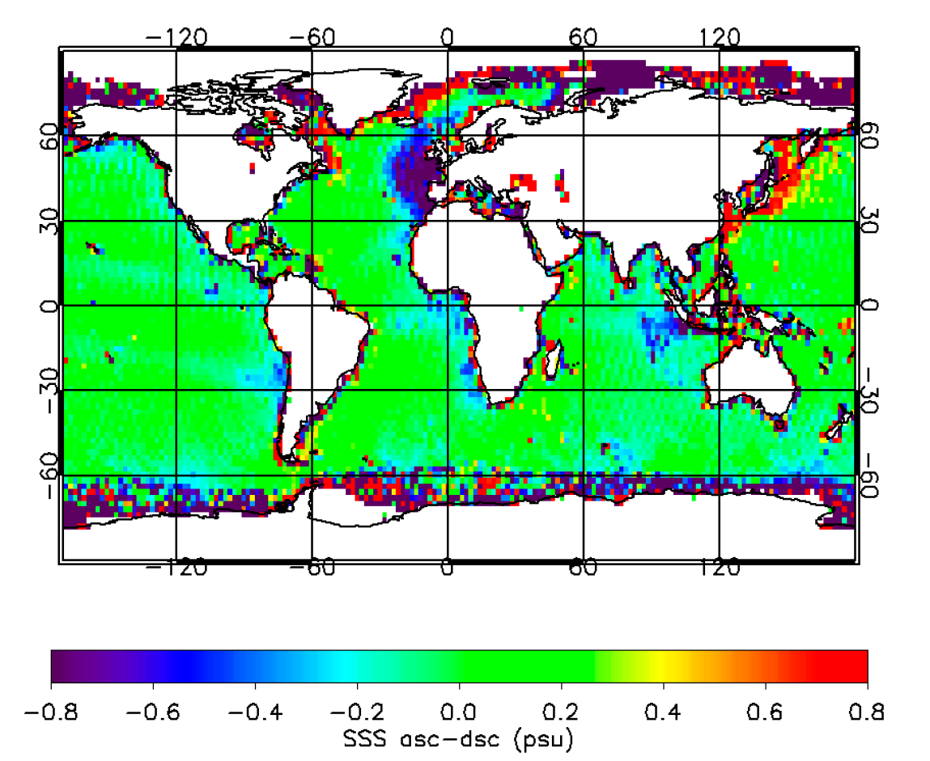
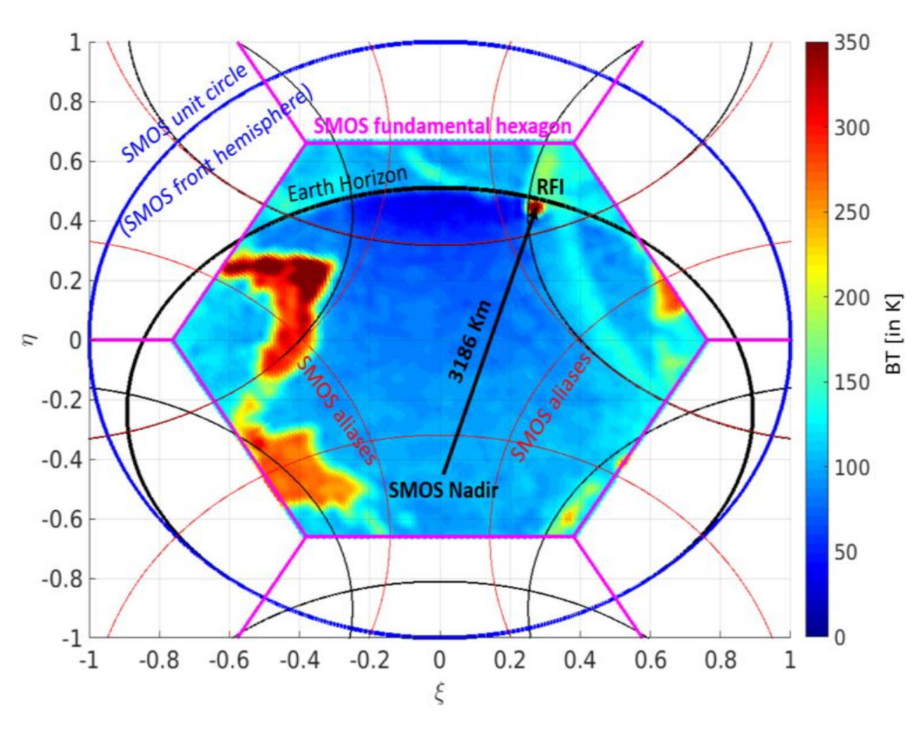
1) When is the EO sensor “present”?
Sometimes it is assumed that only the 3 dB footprint of the satellite needs to taken into account.
However, RFI has been documented to affect sensors 1000s of km away from the boresight.
SMOS and Aquarius have 3 dB footprints of 40 km and 80 km, respectively. And yet…
RFI affecting Aquarius at large distance from the coast
RFI source impacting SMOS from beyond the horizon
Meissner et al., 2018
Report ITU-R RS.2492

Slide 19
1) When is the EO sensor “present”?
So “overpass” is not simply the 3 dB footprint.
The area that triggers an action (e.g. turn off) on the active systems, needs to be sufficiently large to avoid RFI also in the sidelobes of the sensors.
This implies that each “overpass” lasts quite long. Illumination by the 3 dB footprint lasts a few seconds, but the satellite is in visibility for a few minutes, e.g. 15 min for a satellite at 800 km altitude.

Slide 20
2) Number of EO satellites
The number of satellite considered will also play a role in sharing scenarios.
At 1.4 GHz, there are few satellites, currently only 3.
In other bands, there are up to 70-90 satellites between current and planned missions (source: WMO OSCAR).

Slide 21

2) Number of EO satellites
This implies that, depending on the band, active systems may often be triggered to change their behaviour.
Example with 9 satellites

Slide 22
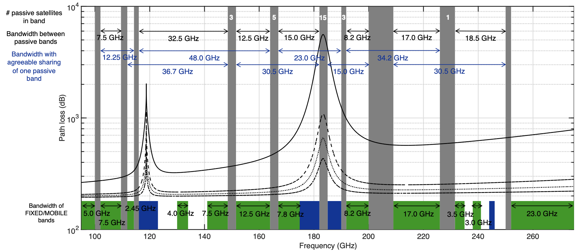
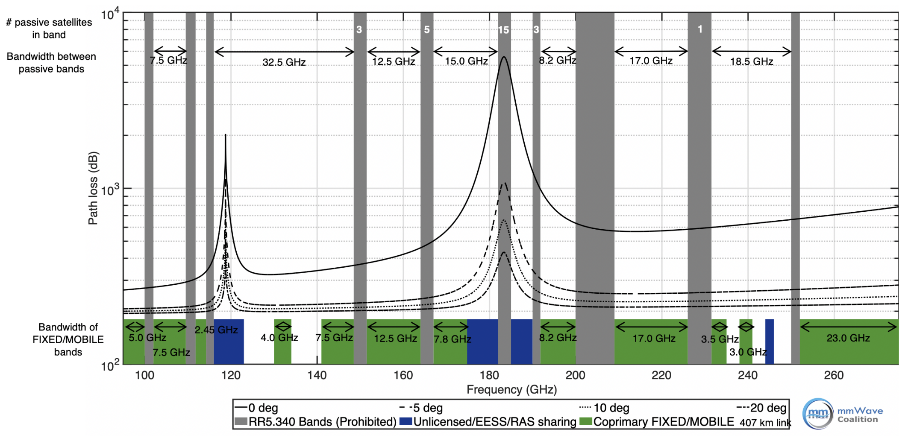
3) Target frequencies
Some research suggests that dynamic spectrum sharing is implemented in purely passive bands:
1.4 GHz (see Khoosha and Mastronarde, 2023, 2024 and 2025; Zheleva et al., 2023; Alam et al., 2024)
23.8 GHz (see Eichen et al., 2021)
> 100 GHz (see Bosso et al., 2021; Polese et al., 2022)
But ITU Radio Regulations clearly prohibit this, and targeting these frequencies first puts EO sensors at a high and unnecessary risk of interference.
Polese et al., 2022

Slide 23
3) Target frequencies
Target frequencies (and applications) should be chosen to reduce existing RFI issues to EO sensors, or to reduce RFI issue that are foreseen based on previous regulatory decisions
E.g. target bands where EO sensors have no protection
  7.3 GHz (see Eichen et al., 2024)
  6.9 GHz
Potential mitigation of WRC-23 decision on IMT?

Slide 24
4) Behaviour during the overpass
These dynamic approaches foresee a change of behaviour during the satellite overpass.
But what exactly?
Lower transmit power → May still be an issue for EO sensors & would it still allow active system operations?
Beamform → For EO, similar impact as lower power. Feasible/acceptable for the active systems?
Turn off → Good for EO sensors. May be acceptable for some active services, but not for others (e.g. mobile)
Move to a different band → Potentially good for EO sensors. But where to find a different band? And if another band is available, why not use it by default?
All this also depends on the duration & frequency of the satellite overpasses.

Slide 25
5) Issue of scale
At any moment, the satellite overpass will cover 1000s of km. This implies a need for:
Need to avoid that success in small-scale experiments are taken as proof of possible coexistence.
Need to define plans for standardization, testing, monitoring & enforcement
Coordination among a potentially large number of emitters
Coordination across countries
Coordination across manufacturers / designs

Slide 26
Possible implications
Challenge | Possible implication
1) Size of the satellite “overpass” | Will shift results to less optimistic values, but don’t fundamentally change the methodology
2) Number of satellites
3) Choice of frequency | Avoiding risks to EO sensors will limit applicability to some bands Purely passive bands need to be preserved
4) Behaviour during the overpass | Need to assess the feasibility / degradation of operations May limit to which active systems this can be applied
5) Issue of scale | How to address implementation across administrations / manufacturers?

Slide 27
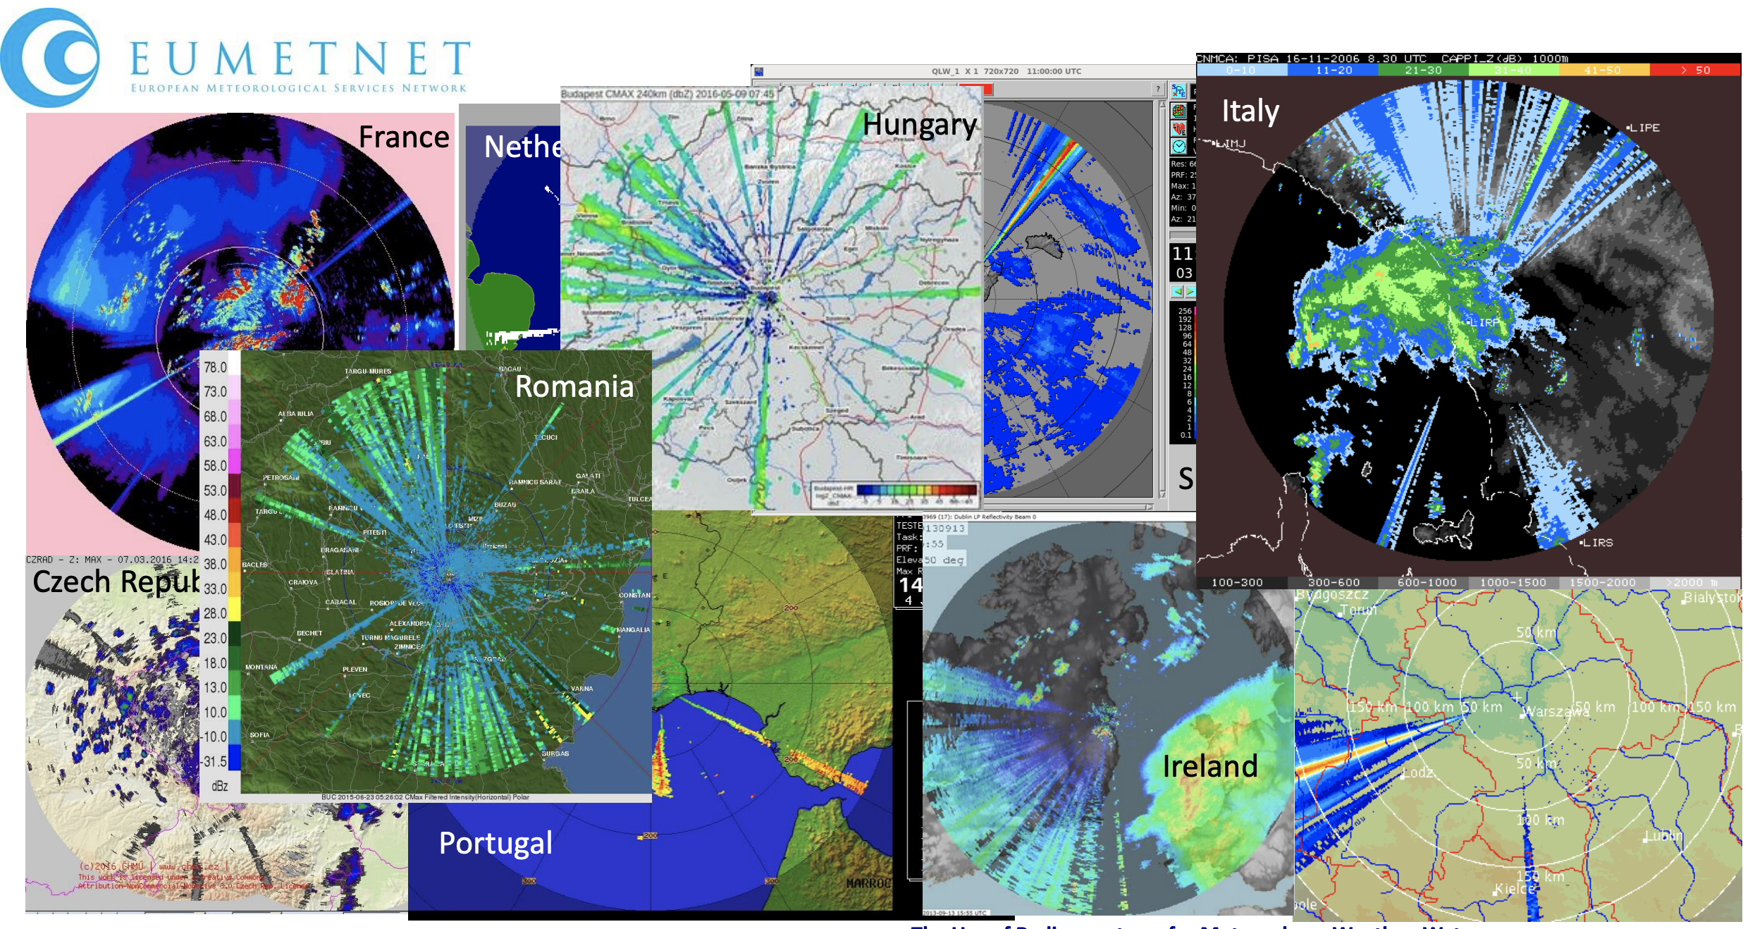
Lessons learnt (Dynamic Frequency Selection @ 5 GHz)
Case of dynamic spectrum sharing involving multiple manufacturers / administrations:
WRC-03 decided that future Wi-Fi systems would share the spectrum with incumbent, including weather radars.
Key to coexistence was the DFS (Dynamic Frequency Selection): a Listen-Before-Talk technology.
Tristan, 2017
But in practice, there were many difficulties: weather radar signals & acquisition schemes vary; imperfect DFS certification tests; DFS deliberately turned off.
As of 2017, 83% of European C-band weather radars are affected by RFI!

Slide 28
SFCG
The Space Frequency Coordination Group (SFCG) is a group where space agencies worldwide discuss various topics related to frequency management.
Dynamic active-passive coexistence was discussed at the last SFCG meeting (June 2025).
The group agreed to create an Action Item on this topic to gather information / views and, if relevant, discuss potential actions.
Next SFCG meeting will take place in July 2026.

Slide 29
Conclusions
Spectrum should be used more efficiently & with fewer RFI
Regarding coexistence with passive EO sensors, some challenging aspects may need to be addressed further:
For the satellite overpasses:
Need to enlarge the area affected by the overpass of the satellite; not just the 3 dB footprint
Need to account for realistic occurrence of overpasses, based on the number of current/foreseen satellites
Need to investigate what happens to the active systems during the overpasses: e.g., is turning off feasible?
For the frequency:
Cannot be done in bands where all emissions are prohibited (see RR No. 5.340)
Should target bands with existing sharing issues
For the scale:
Multiple administrations/companies involved → plan for standardization, testing, monitoring and enforcement
Need to avoid the experience of DFS (Dyn. Freq. Selection) at 5 GHz
Spectrum sharing is a one-way street → once a system is deployed, not reasonable to recall it

Slide 30
Thank you!
Yan.Soldo@esa.int
ESA UNCLASSIFIED – For ESA Official Use Only

